Slide 1

Benchmarking Quantum Phase Estimation with Physical Hamiltonians
Lion in a Box
Ryan Anselm, Justin Beltran, Carson Convery, Ayman Khaleq, Christine Li

Slide 2
Topics
01
02
Our Criteria
Phase Estimation Algorithms
Overview of our methodology
Differences in the quantum circuits and their advantages
03
04
Physical Systems
Conclusions
And how we can utilize their structure for benchmarking
Implications of the benchmark data

Slide 3
01
Our Criteria

Slide 4
Criteria for Benchmarking
Depth - measured on the longest path of the circuit including initialization and subsequent iterations of U
Number of Gates - Total number of gates used in a circuit, including initialization and
Accuracy - measured by probability of obtaining ground state of different physical system (or associated 𝜽)

Slide 5
02
Phase Estimation Algorithms

Slide 6
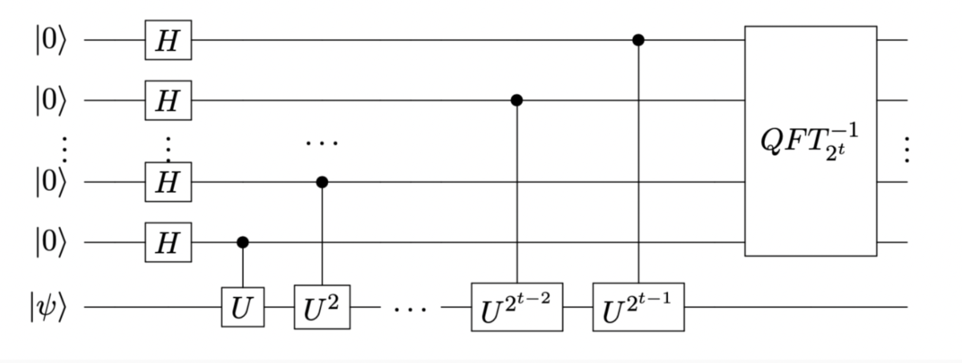
Standard Phase Estimation Algorithm
Overview:
Goal: Given unitary U and its eigenvector, approximate the phase of the eigenvalue, with theta between 0 and 1.
Apply H across m measurement qubits to create equal superposition
Controlled U operations -> Phase Kickback
Inverse QFT
Second H to extract phase
O(2^n) circuit depth for n-bit precision
Notes:
Apply H across top m measurement qubits to create equal superposition
P

Slide 7
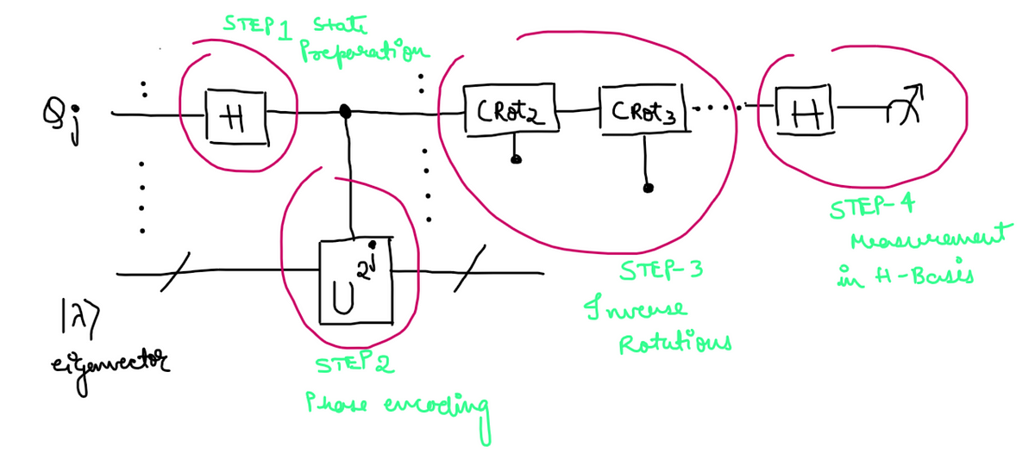
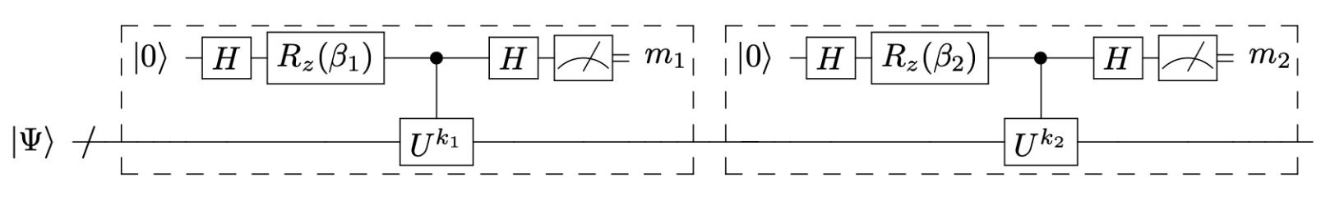
Iterative Phase Estimation Algorithm
Advantages:
Breaks up computation into k stages for precision k, decreasing the depth of the deepest quantum circuit required
Able to achieve lower error rates on near-term quantum computers compared to standard phase estimation
Does not use an inverse Quantum Fourier Transform
Disadvantages
Computes digits in reverse order from least significant to most significant

Slide 8
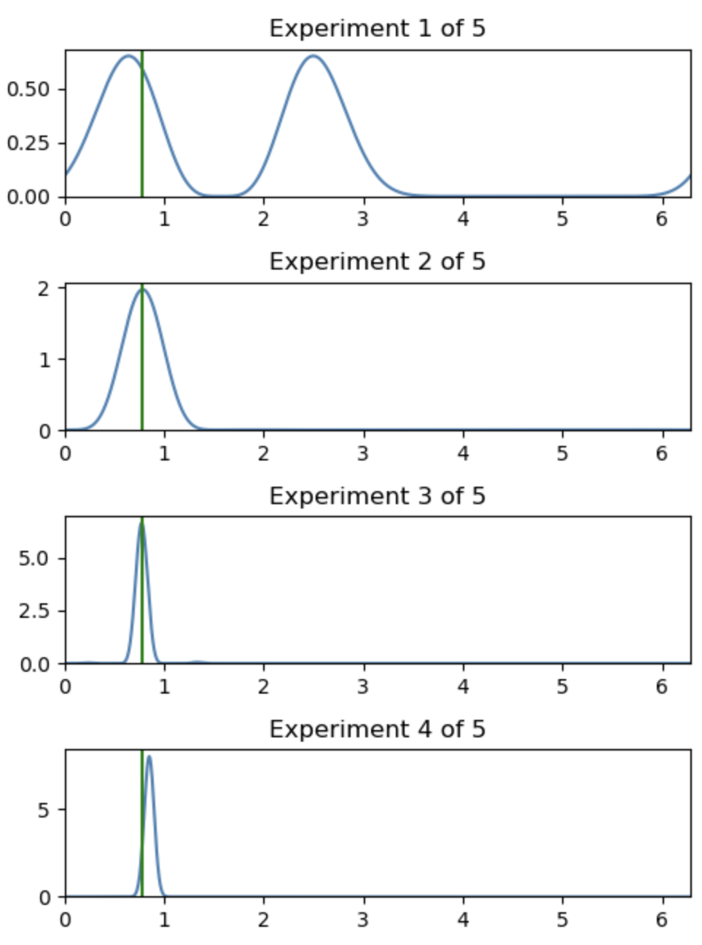
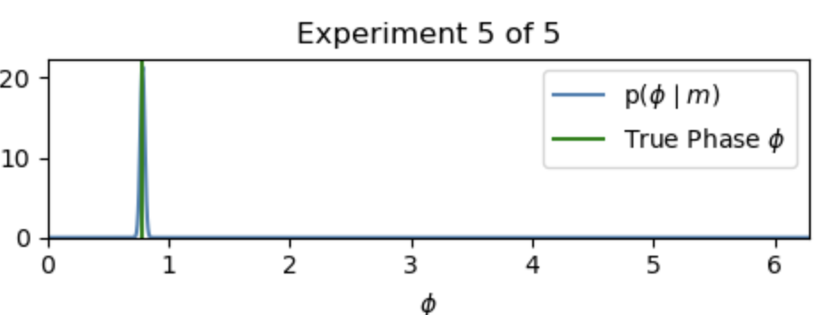
Bayesian Phase Estimation Algorithm
Advantages:
Noise Tamping through Modeling Methods - Depolarizing Noise, Measurement Noise
Less iterations by updating weights - Continuously calculating probability
Disadvantages:
Overhead - quantum/classical hybrid computations
Requires heavier classical post-processing

Slide 9
03
Physical Systems

Slide 10
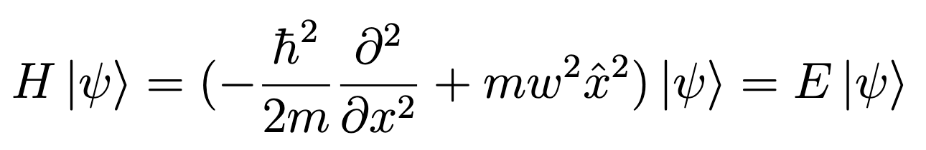
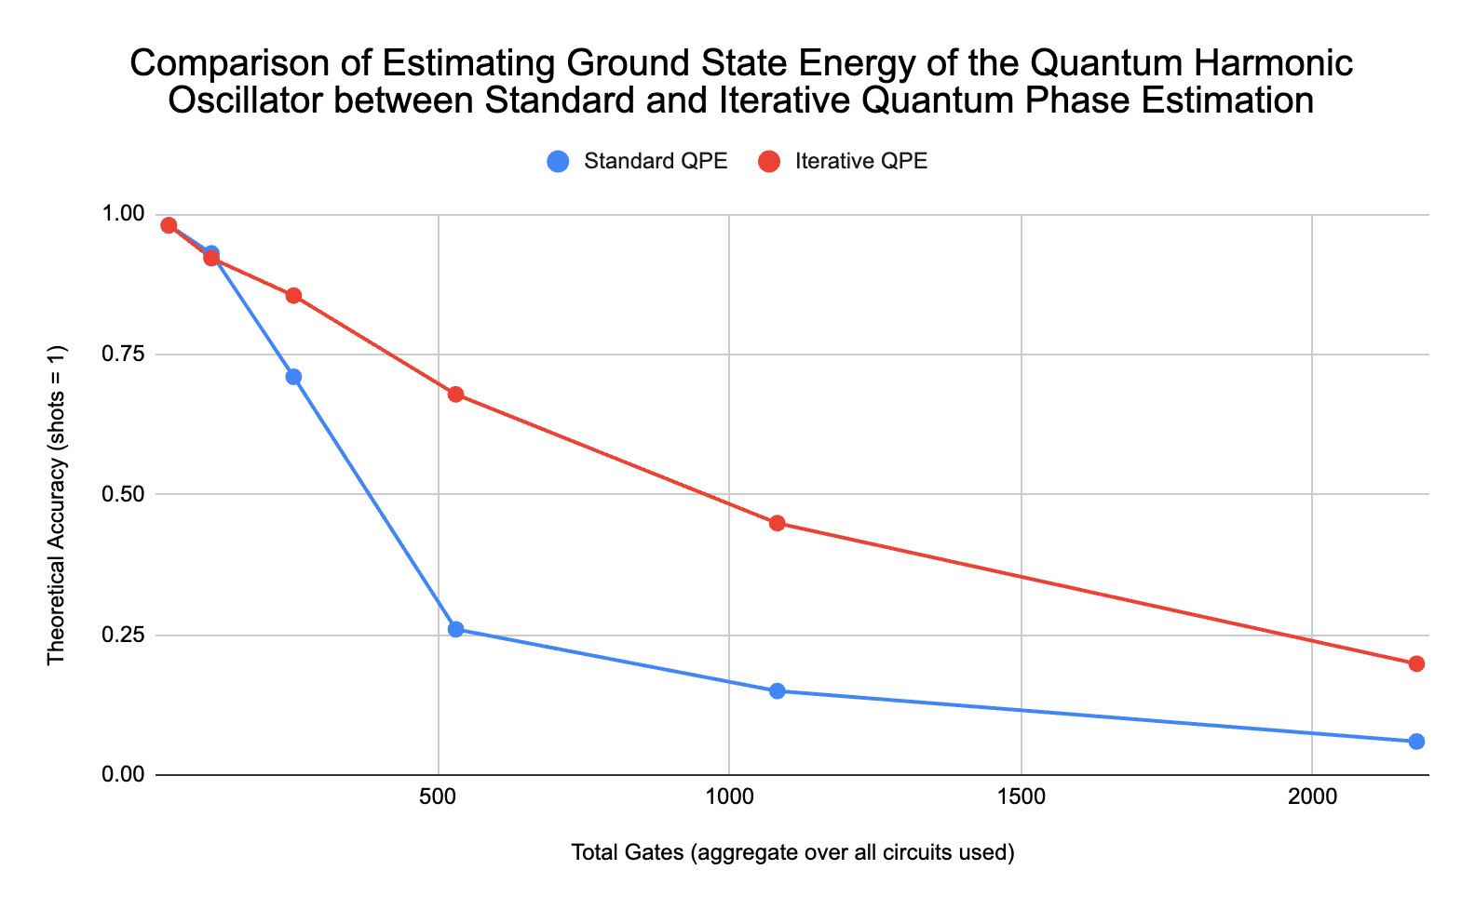
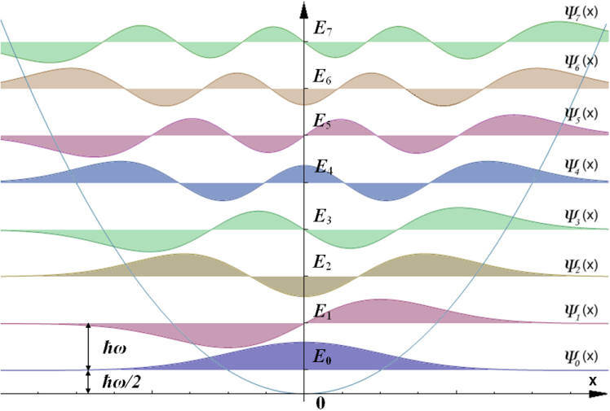
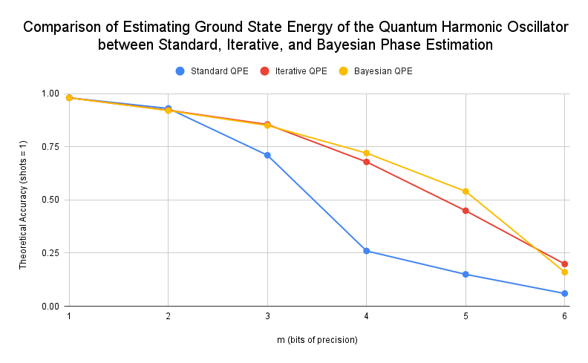
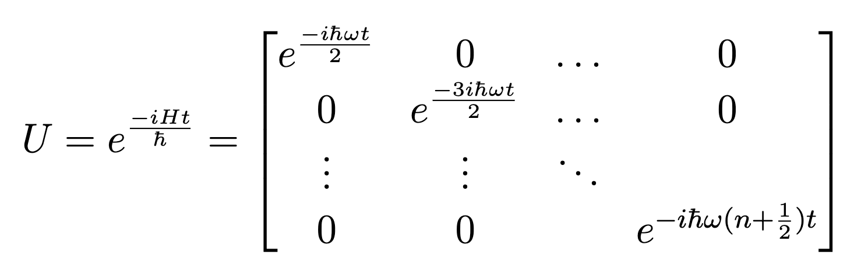
Quantum Harmonic Oscillator Benchmark
Unitary Time Evolution Operator For QHO

Slide 11
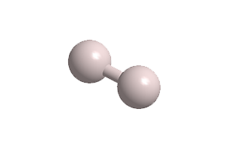
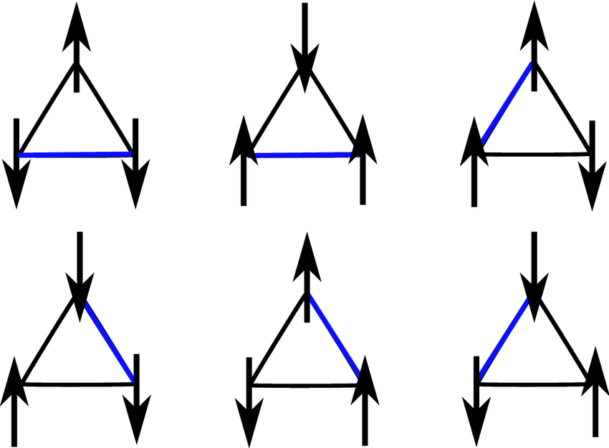
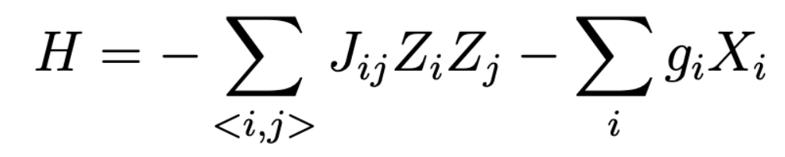
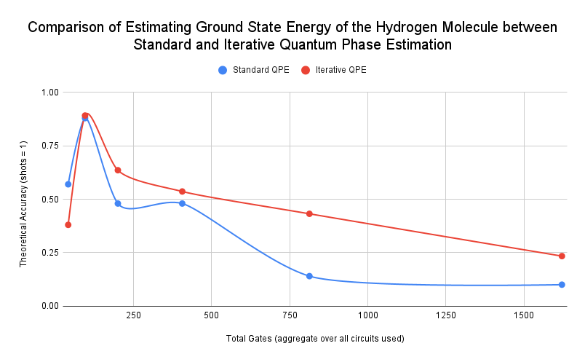
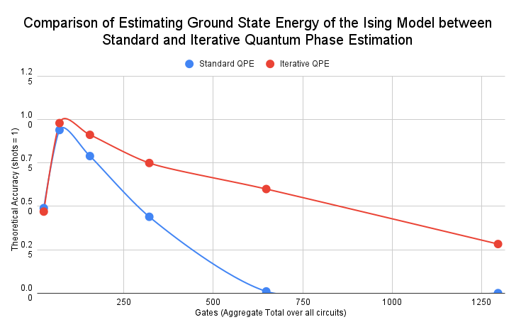
H₂ Molecule and Ising Model
H₂ Molecule Hamiltonian
Triangular Lattice Ising Model

Slide 12
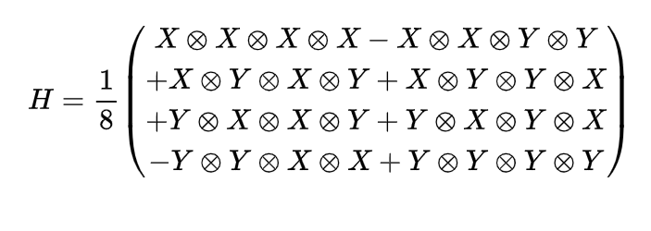
Improving Hamiltonian Simulation
Why this hamiltonian?

Slide 13
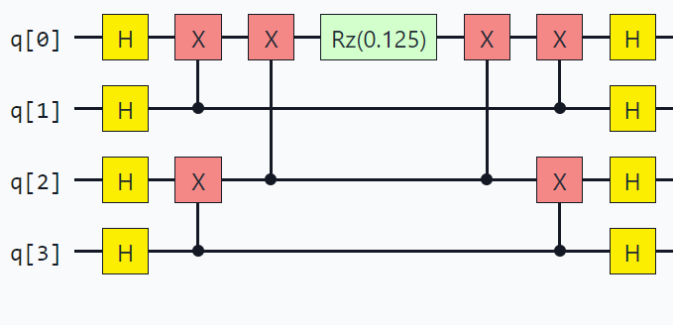
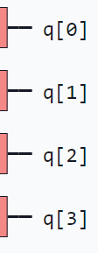
Improving Hamiltonian Simulation
#A- Commutativity of Pauli Matrices + Basis change
…
…
…
…
Deep!

Slide 14
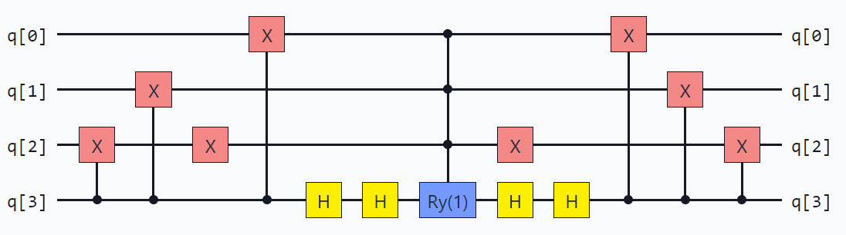
Improving Hamiltonian Simulation
#B- Outer Product and Rank Exploitation
Shallow

Slide 15


Improving Hamiltonian Simulation
Assumption: state preparation to an eigenstate
QFP gives null phase…
> Improve assumption on eigenstate of Hamiltonian

Slide 16
Thank you!

